Slide 1
Detection of people's acceptance of the people's vaccination plan in Spain
based on measurable characteristics
speakers: José Ramón Trillo, Enrique Herrera-Viedma, María del Carmen Aguilar, Francisco Javier Cabrerizo

Slide 2
Index
Introduction
Initial characteristics
Questions
Algorithm creation procedures
Preprocessing
Algorithms
Initial results
Conclusions

Slide 3
Introduction
Research is one of the benchmarks for the advancement of society.
It has already demonstrated this with the research and creation of the Covid-19 vaccine.
With the creation of the vaccine, science has saved millions of lives.
However, research related to Covid-19 continues today.

Slide 4
Introduction
The University of Granada is also contributing its knowledge and research to help curb the physical and psychological consequences of the pandemic.
For this reason, thanks to the MICROBE project, research is being carried out in the field of psychology and computer science. This makes it possible to classify, with real data, the behaviour of people before the evaluation of the Spanish vaccination plan.

Slide 5
Introduction
The following are some examples of University of Granada research related to Covid-19:
Acuña‐Castroviejo, D., Escames, G., Figueira, J. C., de la Oliva, P., Borobia, A. M., & Acuña‐Fernández, C. (2020). Clinical trial to test the efficacy of melatonin in COVID‐19. Journal of pineal research, 69(3), e12683.
Torres Martín, C., Acal, C., El Honrani, M., & Mingorance Estrada, Á. C. (2021). Impact on the virtual learning environment due to COVID-19. Sustainability, 13(2), 582.
Rivera-Izquierdo, M., del Carmen Valero-Ubierna, M., R-delAmo, J. L., Fernandez-Garcia, M. A., Martinez-Diz, S., Tahery-Mahmoud, A., ... & Jimenez-Mejias, E. (2020). Sociodemographic, clinical and laboratory factors on admission associated with COVID-19 mortality in hospitalized patients: A retrospective observational study. PLoS One, 15(6), e0235107.
Manzano, J. V., Pastor, J. A. A., Quesada, R. G., Aletta, F., Oberman, T., Mitchell, A., & Kang, J. (2021). The “sound of silence” in Granada during the COVID-19 lockdown. Noise Mapping, 8(1), 16-31.
Kriaucioniene, V., Bagdonaviciene, L., Rodríguez-Pérez, C., & Petkeviciene, J. (2020). Associations between changes in health behaviours and body weight during the covid-19 quarantine in Lithuania: the Lithuanian covidiet study. Nutrients, 12(10), 3119.

Slide 6
Initial characteristics
A questionnaire survey of 253 people was carried out.
This questionnaire has closed questions similar to the workshop held.
The questionnaire contains X questions.
The questionnaire was made in May and June.

Slide 7
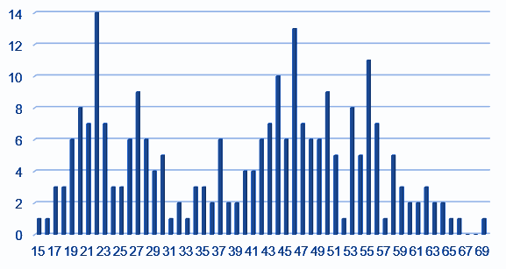
Questions (Age)
The study was conducted for the entire range of the population.
We have a population range [15,69].

Slide 8
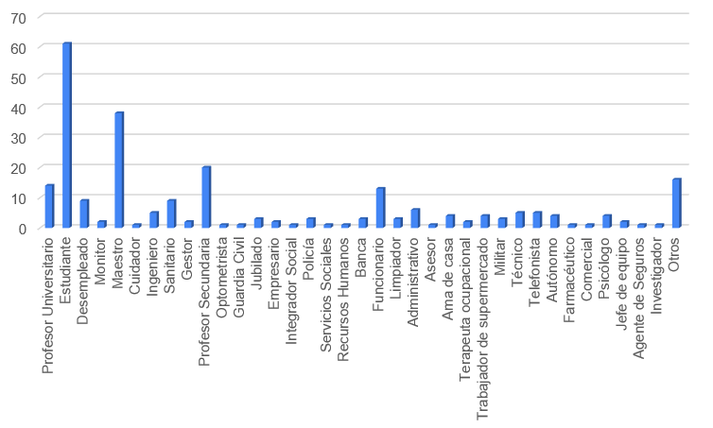
Questions (Jobs)
Participants are asked what their job is.
You can see that there are a lot of students. This is due to the fact that people in Spain are usually studying until they are 23 years old.

Slide 9
Questions (City)
People were asked about their place of residence.
This variable shows different towns in Spain.
The only one belonging to a foreign town is a Spanish expert interviewed who is from Madrid but lives in Milan.

Slide 10
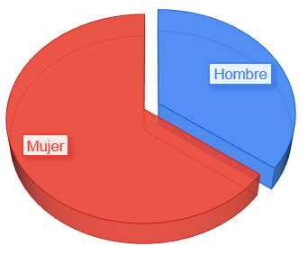
Questions (Gender)
Participants were asked about gender.
It can be seen that almost two thirds of the participants are women compared to almost one third who are men.

Slide 11
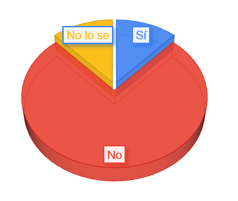
Questions (Covid)
Participants were asked if they had had Covid-19.
The majority replied that they had not. However, there is a significant percentage who do not know.

Slide 12
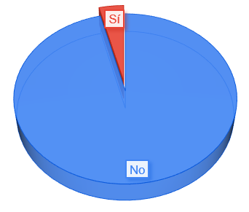
Questions (Disabled)
The participant is asked if he/she has a disability. The majority answer is no.

Slide 13
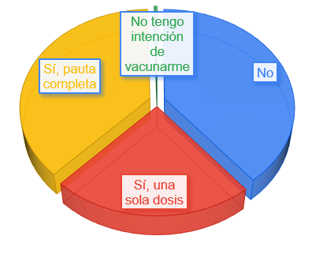
Questions (Vaccination intention)
Participants are asked whether they have been vaccinated and also about their intention to be vaccinated.
As can be seen, there is one person who does not intend to be vaccinated. Whereas there was a percentage of the population who had not been vaccinated in May and June 2021.

Slide 14
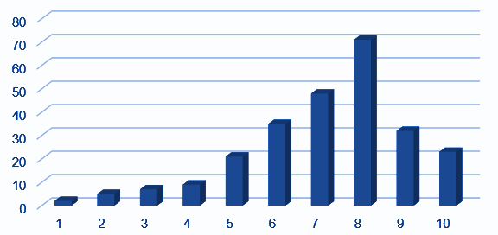
Questions (vaccination strategy)
This question is used to train and validate the model used.
It asks how they think the vaccination plan is in Spain.
The rating is in the range [1,10].

Slide 15
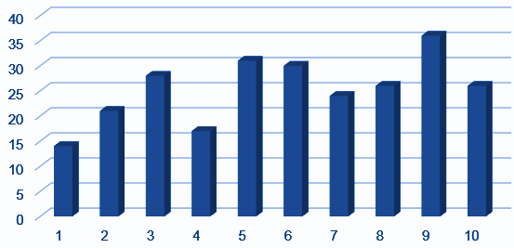
Questions (Avoid pandemic)
He wonders whether the pandemic could have been prevented.
The rating has a range [1,10]. Where 1 is the value shows that it is unpreventable and 10 is preventable.

Slide 16
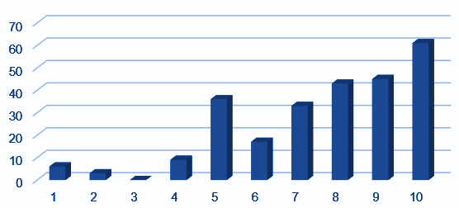
Questions (The past was better)
He wonders whether the past, before the coronavirus, will be better than the future, after the coronavirus.
The assessment is between [1,10]. Where the value 1 is that the future will be better than the past and 10 is that the past will be better than the future.

Slide 17
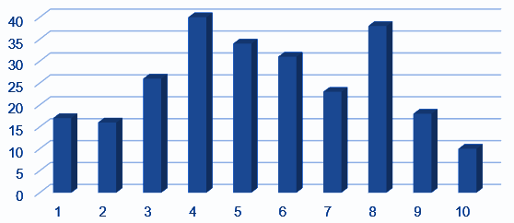
Questions (Previous studies)
He wondered whether previous studies that existed had helped to minimise the effects of the pandemic.
It is rated between [1,10]. Where 1 is absolutely against and 10 is absolutely in favour of the comment.

Slide 18
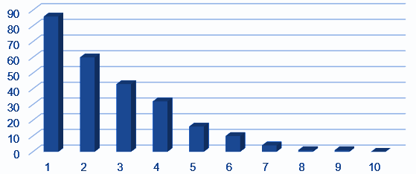
Questions (Preparing the company)
He wonders whether society was prepared for the pandemic.
It is rated between [1,10]. Where 1 is unprepared and 10 is prepared.

Slide 19
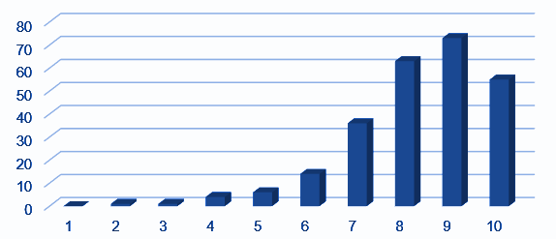
Questions (Digitalization of society)
He wonders whether the pandemic has accelerated the digitalisation of society.
The range is [1,10] where 1 is strongly disagree and 10 is strongly agree.

Slide 20
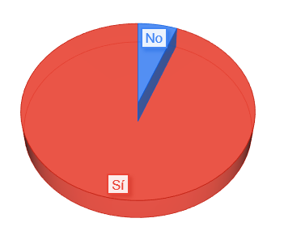
Questions (Changed social habits)
The question asks whether there have been social changes brought about by the pandemic.
The majority answer is yes.

Slide 21
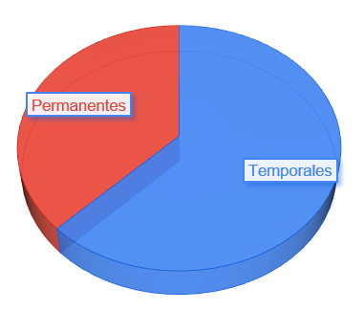
Questions (Changes are permanent or temporary)
Questions whether the habits acquired in the pandemic are permanent or temporary
Most participants responded that the habits would be temporary.

Slide 22
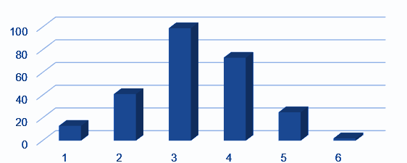
Questions (Action by the authorities)
The question asks whether the decisions taken by the authorities are right or wrong.
It is rated between [1,5]. Where they 5 are excellent and 1 are horrible.

Slide 23
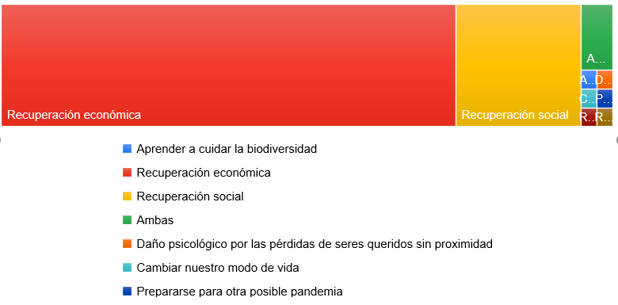
Questions (most difficult as a society)
This question is a question asking users what it will be like for society to recover in the future.
Participants are given 4 options:
Social recovery
Economic recovery
Both
Other: Where participants can write their opinions

Slide 24
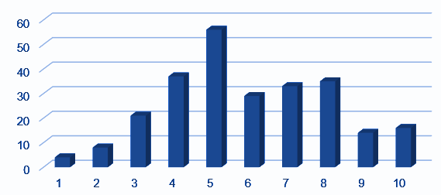
Questions (social recovery is a more important than economic recovery)
Participants are asked how much more important social recovery will be than economic recovery.
It is rated from [1,10]. Where 1 is that economic recovery will be more important and 10 that social recovery will be more important.

Slide 25
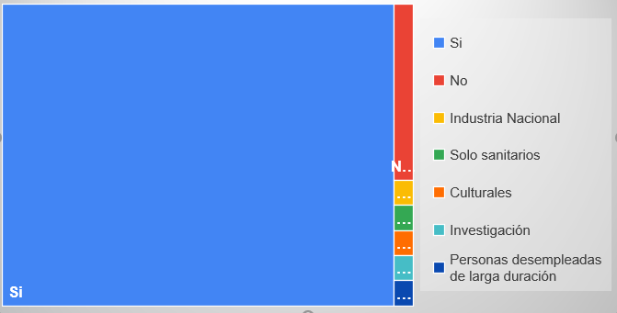
Questions (public sectors)
They wonder whether public sectors will need to be strengthened after the pandemic.
This has three options:
Yes
No
Other: Where participants can write their opinions

Slide 26
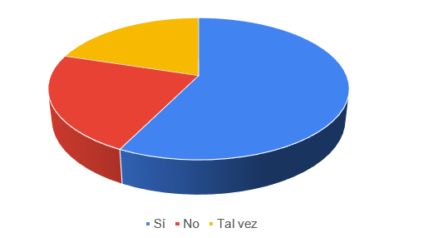
Questions (climate change)
Participants are asked whether climate change will be responsible for future pandemics.
They have three options:
Yes
No
Maybe

Slide 27
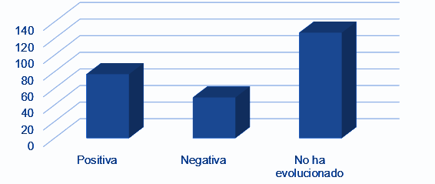
Questions (Evolution of society)
Participants are asked whether society has evolved during the pandemic.
They have three options:
Positively
Negatively
No evolution

Slide 28
Questions(Research)
Wonders if research has been strengthened during the pandemic
There are two options:
Yes
No

Slide 29
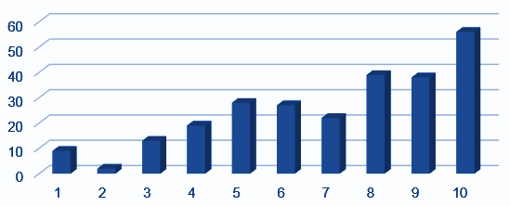
Questions()
It asks whether the participants have received sufficient information from the media or whether they have been over-informed.
The interval moves in a range [1,10]. Where 1 is sufficient and 10 is overinformation.

Slide 30
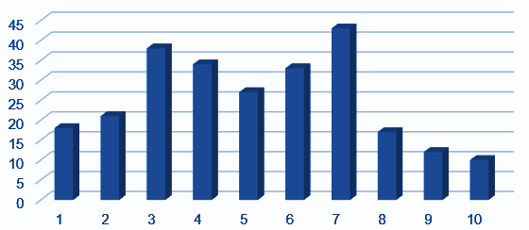
Questions(stringency of measures)
Participants are asked whether sanction/salvation/etc. measures have been rigorously applied during the pandemic.
They score between [1,10]. 1 being not very rigorous and 10 being too rigorous.

Slide 31
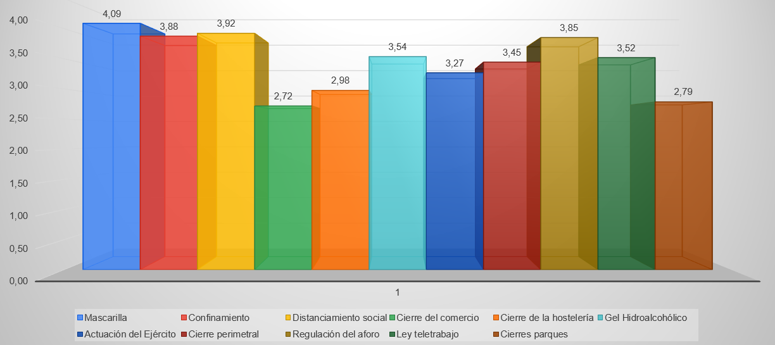
Other questions

Slide 32
Other questions
The evaluation interval is [1,5].
1 is a rating meaning not very useful.
5 is a rating that means very useful.

Slide 33
Algorithm creation procedures
Initially, take the variable that assesses the vaccination plan and divide it.
They are divided into 2 groups, taking as a reference the median which is equal to 7:
If the value of that variable is less equal to 7 it is assigned a label with value 0.
If the value of this variable is greater than 7, a label with a value of 1 is assigned.

Slide 34
Algorithm creation procedures
The median has been chosen because it allows to create a dataset that has the most balanced dataset possible.
For this case, it is impossible because you have an odd number of participants.
The dataset is divided using an 80-20 hold out:
A training dataset is created with 80% of the data.
A test dataset is created with 20% of the data.

Slide 35
Preprocessing
On the one hand, the following procedure is done to the train dataset:
The qualitative variables are transformed into different Boolean quantitative variables.
Qualitative variables that do not provide information are eliminated.
The data of the set is balanced.
The data are normalised.
On the other hand, the following procedure is performed on the test dataset:
The qualitative variables are transformed into different Boolean quantitative variables.
Qualitative variables that do not provide information are eliminated.
The data are normalised.

Slide 36
Algorithms
Different algorithms have been applied, such as the following:
Similarity algorithms.
Explainable algorithms.
Algorithms based on linear regression.

Slide 37
Initial results
The first results that are being obtained show the following:
Not all variables provide information to rank the algorithm.
It is possible to understand why participants make one decision or another.
The algorithms used have to be adapted to the amount of data that is available.
The algorithm has an accuracy of more than 75%.

Slide 38
Conclusions
A questionnaire has been carried out to obtain real data.
An Artificial Intelligence based algorithm is being designed to detect the assessment of the research plan.
Algorithms adapted to the data we have are being used.

Slide 39
Conclusions
Algorithms based on deep learning have been discarded, due to the lack of data and the overfitting performed by these algorithms.
First results show that there are algorithms that are able to classify data correctly with more than 75% accuracy.
The first results show that there are behavioural patterns that allow to detect the valuation of future participants.

Slide 40
THANK YOU FOR YOUR ATTENTION
https://www.ugr.es/
jrtrillo@ugr.es

